Slide 1

Cyberbullying Detection
By:
John Hani
Mohamed Nashaat
Mostafa Ahmed
Zeyad Emad
Under supervision of :
Dr. Eslam Amer
Eng. Menna Gamil

Slide 2
Agenda
Introduction
Related work
Problem Statement
System overview
Project Deliverables

Slide 3


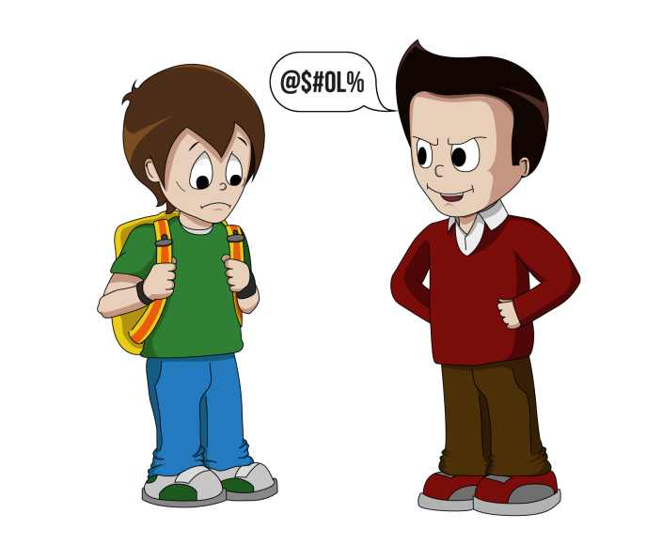

Introduction
Use superior strength or influence to intimidate someone

Slide 4


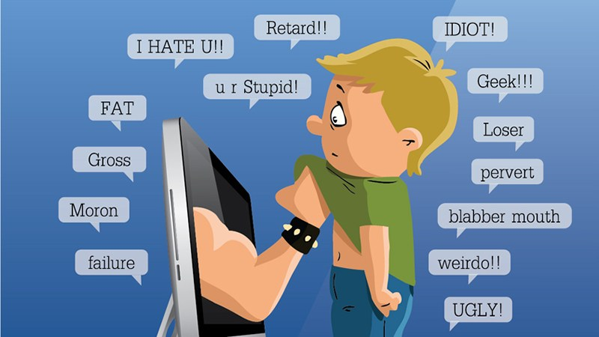
Cyberbullying has been manifesting our youth for quite sometime, due to them being involved in one form of social media communication or another.
Sarcasm which the use of irony to mock or convey contempt.

Slide 5
More than 1 in 3 young people have experienced cyber threats online.
Over 25 percent of adolescents and teens have been bullied repeatedly through their cell phones or the Internet.
National Crime Prevention Council, “Cyberbullying”
i-SAFE Inc., “Cyber Bullying: Statistics and Tips”
Richard Webster, Harford County Examiner, “From cyber bullying to sexting: What on your kids’ cell?”

Slide 6
Related Work
Motivation
Most of the technical studies have focused on the detection of cyberbullying through identifying harassing comments rather than preventing the incidents by detecting the bullies.
Main Problem
They focused on the detection of bully users in online social networks and the efficiency of both expert systems and machine learning models for identifying the potential bully users.
Contribution
They used three machine learning methods: a Naive Bayes classiﬁer, a classiﬁer based on decision trees and Support Vector Machines (SVM) with a linear kernel
Precision
The discrimination capacity of the MCES was 0.72..

Slide 7
Related Work
Motivation
There is an enormous amount of information to manually flag offensive comments or posts. So an automatic classifier that is fast and effective is needed to solve this problem.
Main Problem
There are challenges like: special characters in comments and the detection of insults and offensive comments
Contribution
They proposed 2 new hypotheses for detecting cyberbullying and it has increased the precision by 4 percent.
Precision
70.0% precision using SVM
64.0% precision using logistic regression

Slide 8
Problem Statement
Data in the internet nowadays are too huge to be monitored manually by humans to detect cyberbullying.
In previous cyberbullying detection frameworks there has been a problem in detecting false positive cyberbullyings cases.
So we aim to Enhance the accuracy of cyberbullying detection using natural language processing and contextual analysis.
In cyberbullying detection frameworks they cant detect sarcasm so we aim to detect sarcasm along with cyberbullying.

Slide 9
Pre-processing text (Noise Removal)
<h1>THIS IS A TEST MESSAGE \N</h1>
Strip HTML
THIS IS A TEST MESSAGE \n
Remove Encoding Parts
THIS IS A TEST MESSAGE
Lower Text
this is a test message
Tokenize Text
[this , is , a , test , message]
Notes:
<number>

Slide 10
Pre-processing cont. (normalization)
These are 2 test messages
Replace Numbers
These are two test messages
Remove Stop Words
[two , test , messages]
Stemming
[two , test , mesg]
Lemmatization

Slide 11
Feature extraction
TF-IDF
N-Grams
Contextual analysis
Sentiment Analysis

Slide 12
Processing
Classifiers
SVM
Random Forest

Slide 13
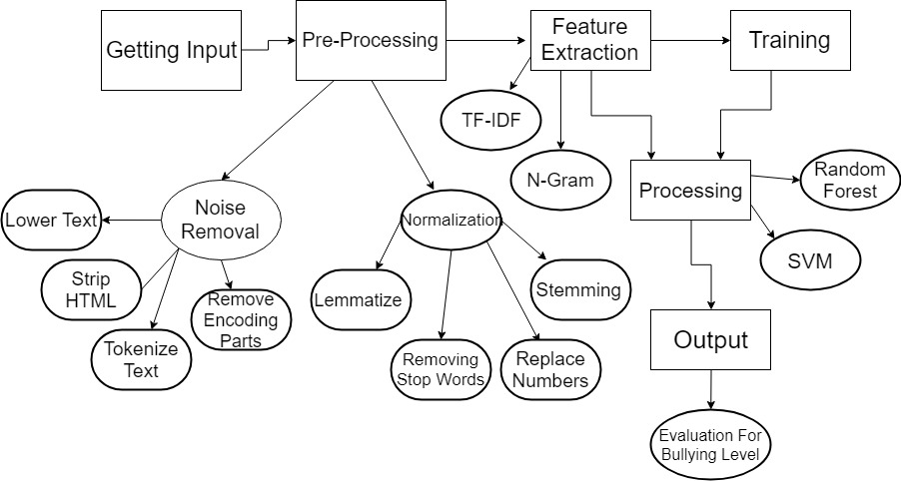
Wrap up diagram

Slide 14
Any Questions?

